Slide 1

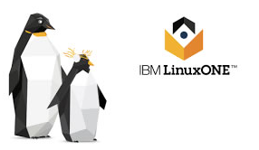
HYPERLEDGER FABRIC FOR THE ENTERPRISE Privacy and Security Strategies
Presentation
Grant Steinfeld¹
¹ Developer Advocate – Blockchain and Java, IBM @gsteinfeld
https://bit.ly/2xf0PvK

Slide 2
Hyperledger Fabric permissioned private blockchain Trust and Identity Security and Privacy

Slide 3



The Facts
Cyber attacks cost businesses as much as $400 billion a year.²
Hackers stole $40 million from Binance cryptocurrency exchange
Banks spend $1 billion a year on identity management solutions²
175M records breached in 2017 that exposed millions of people’s identities¹
Bitpoint cryptocurrency exchange loses $32 million in hack
It could have been your identity.
[1] http:jk.pdf
Notes:
http://www.idtheftcenter.org/images/breach/2017Breaches/DataBreachReport_2017.pdf [1]
https://www.wired.com/beyond-the-beyond/2017/07/global-cybercrime-costs-trillion-dollars-maybe-3/ [2]
https://www.accenture.com/_acnmedia/Accenture/Conversion-Assets/DotCom/Documents/Global/PDF/Dualpub_9/Accenture-Future-Identity-Banking.pdf [3]

Slide 4
PUBLIC VS PRIVATE blockchains
 | Public | Private
Access level | anyone | 1-n organizations
Participation | Permissionless Anonymous | Permissioned Identities are known Pre approved participants invited
Security / Consensus | POW POS | Voting
Performance | Single chain - Slow | Lighter/ Channel - Segmented chains Fast
Notes:
Public and private blockchains are both decentralized, peer-to-peer networks where each participant maintains a replica of a shared ledger that stores digitally signed transactions. This ledger can only be appended to, but not edited. Participants in a blockchain keep this ledger in sync through a consensus protocol. This creates a guarantee on the immutability of the ledger which cannot be corrupted even if there are some malicious participants on the blockchain.
The difference between public and private blockchain is related to the type of participants allowed within the network that maintain the ledger and execute the consensus protocol.

Slide 5
IDENTITY!!!
No longer Anonymous
Notes:
Additional security - ACL

Slide 6
HLF REAL USE CASES
Supply Chain
Trade Financing
Education and Training
Smart Energy Management
Notes:
“Hyperledger is an open source collaborative effort created to advance cross-industry blockchain technologies. It is a global collaboration, including leaders in finance, banking, Internet of Things, supply chains, manufacturing, and Technology.”

Slide 7
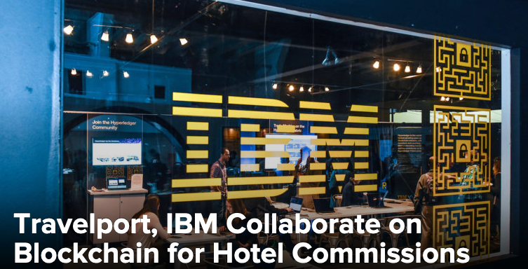



HLF -> ENTERPRISE - IBM
guarantee commissions paid to travel agencies.
combat misinformation and adulterated media
food supply chain, a move that will likely drive unprecedented visibility and veracity into the sourcing and certification of fresh produce and proteins.
TradeLens blockchain-enabled digital shipping platform continues
expansion with addition of major ocean carriers Hapag-Lloyd and Ocean Network Express
Notes:
“With travelers having endless options for accommodations, a booking alone is not enough to provide a commission to an agency… With blockchain, we’re able to reduce costs and ease burdens for all parties involved by improving transparency, accuracy and efficiencies to enhance the process.”
TradeLens blockchain-enabled digital shipping platform continues expansion with addition of major ocean carriers Hapag-Lloyd and Ocean Network Express
News Provenance Project explains how the storied newspaper’s Research and Development team plans to use Hyperledger Fabric’s permissioned blockchain to authenticate news photographs in partnership with IBM Garage, the tech giant’s accelerator program.
The project aims to combat misinformation and adulterated media, which it argues harms small and large publishers alike. “News consumers [who] are deceived and confused…eventually become fatigued and apathetic to news,” the website says.

Slide 8
















Global trade is highly inefficient and burdened by paper-based processes
Inland Transportation
Data trapped in organizational silos
Manual, time-consuming, paper-based processes
Clearance takes too long and is often subject to fraud
High costs and poor customer service .
Customs Brokers
Shippers / Beneficial Cargo Owner
Supply Chain Visibility Systems
Customs Systems
Trade Associations
Ports and Terminals
Supply Chain / Transportation Management Systems
Ocean Carriers
Freight Forwarders / 3PLs
Authorities
Port Community Systems; Terminal Operating Systems
Financial / Insurance Services

Slide 9






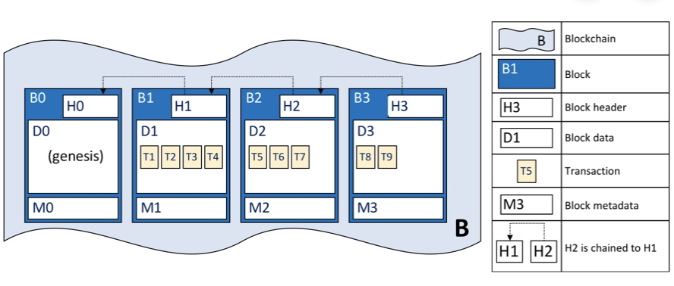









The TradeLens Platform - Digitizing the global supply chain
Inland Transportation
Connects the ecosystem
Drives true information sharing Fosters collaboration and trust Spurs innovation
Customs Brokers
Shippers / Beneficial Cargo Owner
Supply Chain Visibility Systems
Customs Systems
Ports and Terminals
THE PLATFORM IS BUILT ON AN OPEN TECHNOLOGY STACK AND IS UNDERPINNED BY BLOCKCHAIN TECHNOLOGY
Trade Associations
Supply Chain / Transportation Management Systems
Ocean Carriers
Freight Forwarders / 3PLs
Authorities
Port Community Systems; Terminal Operating Systems
Financial / Insurance Services

Slide 10




TradeLens and Blockchain
Blockchain addresses the underlying challenges inherent in collaborating across a distributed, fragmented supply chain ecosystem
Shared ledger
Smart contract
privacy
TRUST
Append-only distributed system of record shared across business network
A network of industry participants maintains a distributed, permissioned ledger with copies of document filings, relevant supply chain events, authority approval status, and full audit history; every change results in a new, immutable block
Shared business logic governing what transactions may be written to the ledger
Cross-organizational business processes, such as import and export clearance, are pre-programmed and built into Blockchain and distributed to and executed on the network, preventing any member from changing the business logic
Ensuring appropriate visibility; transactions are secure, authenticated and verifiable
Cryptography enables permissioned access so only the parties participating in a specific shipment can submit, edit or approve related data
Transactions are endorsed by relevant participants
Information such as documentation filings and authority approvals can only be changed if endorsed by the parties taking part in the shipment; full audit history maintained on the Blockchain

Slide 11
HLF - Clever Consensus
occurrence of delivery faults when many untrusted orderers are employed. Thus, the consensus algorithm must be able to reach consensus despite faults. Thus, Hyperlefger Fabric uses a pluggable algorithm, that allows customizations, depending on the specific use case of each application. For example, to deal with the delivery faults, BFT can be used. Instead of imposing a one-size-fits-all approach, Hyperledger lets users choose the best algorithm for each application.
Notes:
Many options
Ethereum is a permissionless blockchain platform that achieves consensus at the ledger level, the Hyperledger fabric is a permissioned/private platform that has a broad understanding of consensus. Obviously, this has an important impact on how consensus works. Let's have a closer look. In Ethereum, nodes have always the same role. But, with Hyperledger Fabric, nodes can have different roles when a consensus needs to be reached: - clients: act on behalf of users and create transactions. - Peers: keep the ledger and get update messages from orderers for writing new transactions. Messages are supposed to be ordered - Endorsers: subclass of peers that check if a transaction has the required signatures and, if true, they endorse it. - Orderers: provide the means to broadcast the messages that contain transactions.

Slide 12
So how do we ensure Confidential Compute
on Hyperledger Fabric?

Slide 13


Hyperledger Fabric Architecture
External-CA
Fabric-CA
optional
Membership
Services
optional
Admin
Peer
(1) Endorse
Endorser
Client
Application
SDK (HFC)
Committer
(2) Order
O
O
(3) Validate
Ledger
'
Chaincode
A
O
B
Wallet
Events
!
Ordering-Service
Hyperledger Fabric Network
CA: Certificate Authority

Slide 14
Fabric Wallets
There are different types of wallets according to where they store their identities:
FileSystem: This is the most common place to store wallets; file systems are pervasive, easy to understand, and can be network mounted. They are a good default choice for wallets.
In-memory: A wallet in application storage. Use this type of wallet when your application is running in a constrained environment without access to a file system; typically a web browser. It’s worth remembering that this type of wallet is volatile; identities will be lost after the application ends normally or crashes.
Hardware Security Module: A wallet stored in an HSM. This ultra-secure, tamper-proof device stores digital identity information, particularly private keys. HSMs can be locally attached to your computer or network accessible. Most HSMs provide the ability to perform on-board encryption with private keys, such that the private key never leave the HSM.
CouchDB: A wallet stored in Couch DB. This is the rarest form of wallet storage, but for those users who want to use the database back-up and restore mechanisms, CouchDB wallets can provide a useful option to simplify disaster recovery.
https://hyperledger-fabric.readthedocs.io/en/release-1.4/developapps/wallet.html

Slide 15
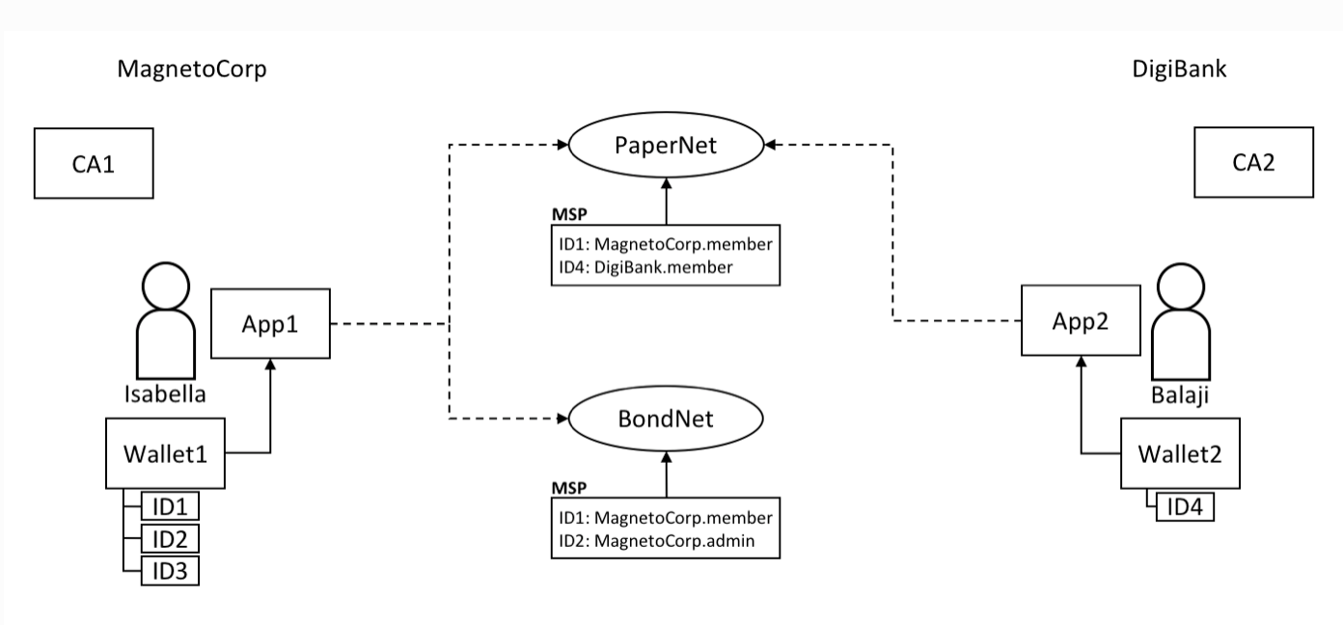
Fabric Wallet
https://hyperledger-fabric.readthedocs.io/en/release-1.4/developapps/wallet.html

Slide 16
Ordering Service – 3 consensus protocols
Apache Kafka and Zookeeper
Crash Fault Tolerance
Solo – dev only
Raft ( recommended )
Distributed ordering
Future Multiple ordering plugins are being developed:
BFT Smart
Simplified Byzantine Fault Tolerance (SBFT)
Honey Badger of BFT
Notes:
3 consensus protocols expected:
Raft – Allows a more distributed ordering service - https://developer.ibm.com/articles/blockchain-hyperledger-fabric-ordering-decentralization/
SOLO - single node for development. Like No-ops but single node and proper consensus.
Kafka – ordering nodes need to be trusted for confidentiality, ordering-service must not leak across channels. Peers not trusted. Access control on the channel. The ordering-service sees the transactions, unless encrypted by the chaincode. Crash fault tolerant.

Slide 17
Touchpoints
Distributed Compute – State Machine –
SmartContracts
Async environments like the Internet
SRE / Security
Pen testing TLS

Slide 18


Malicious Attacks
Peer pull requests / Auditor Role
Continuous Integration – DevOps Infra
EXTERNAL
INTERNAL
Notes:
Consurtium
Nature of blockchain
Privacy
External
Hackers – indication of environment/cloud/datacenter setup wrt security
Industrial Espionage, bored summer vacation

Slide 19
Security
51% attack?
SecOps
Platform
SRE / Security
Pen testing TLS
Notes:
Hyperledger Fabric undergoes periodic Security and License Audits whose results are publicly
A security assessment for v1.1 was published by Nettitude in September of 2017, and , and the assessment for v2.0.x is in progress.
IBM Cloud requires that all services undergo pen testing and that all endpoints use TLS. Specifically,
TLS 1.2 is enabled for all endpoints. All communication between nodes (peer to peer, peer to orderer) is secured with TLS and all communication from the UI to the nodes is also TLS
IBM Blockchain Platform will have support for HSM in 3Q.

Slide 20
SmartContract - chain code

Slide 21
Flexibility choices to run Hyperledger Fabric
VMWare OpenStack
Cloud / Hybrid cloud
Security Improvement
COMMODITY
HARD
Intel – Linux
IBM Power - Linux
IBM Z
IBM LinuxONE
IBM Cloud Private (ICP)
On premises
Notes:
Because of its distributed architecture, blockchain is best suited for the hybrid cloud model and can be deployed both in the public cloud and on premises.
The decision on where to deploy block- chain could, for example, depend on if a managed service is preferred for ease of use, or whether government, industry, or corporate regulations mean that data needs to be held locally.

Slide 22
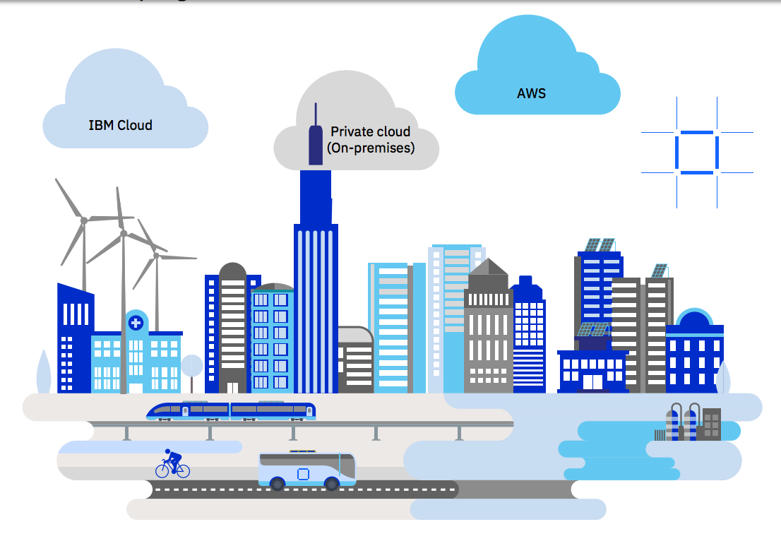
Deploy Hyperledger Fabric ot IBM Blockchain – ANYWHERE!
Notes:
Because of its distributed architecture, blockchain is best suited for the hybrid cloud model and can be deployed both in the public cloud and on premises.
The decision on where to deploy block- chain could, for example, depend on if a managed service is preferred for ease of use, or whether government, industry, or corporate regulations mean that data needs to be held locally.
next
You have Developed your first Hyperledger Fabric application How to get it into the cloud
Many options now
Just announce IBP anywhere!
A full-stack cloud platform that spans public, private and hybrid environments.
IBM cloud – reliabily – scalability – speed – IBM Garage / Consulting …
Build with a robust suite of advanced data and AI tools, and draw on deep industry expertise to help you on your journey to the cloud.
--------------------------
Hybrid Cloud on IBM Z

Slide 23
LinuxONE Security Enables Blockchain
Built-in encryption
Key management
Workload isolation
IBM Secure Service Container
Notes:
The IBM LinuxONE platform is designed to make applications
Perform faster and more efficiently
with the highest levels of security
Customized Go language

Slide 24

VM
Red Hat
SuSE
encryption
END TO END
Built in Encryption
LinuxONE hardware encryption:
Dedicated I/O processors
Crypto processors built right into microprocessor cores
Additional dedicated crypto processors via add-on accelerators
IBM Cloud Hyper Protect Crypto Services
IBM Key Protect
IBM Cloud data
IBM Secure Containers
Notes:
Encryption and decryption can decrease performance, and Linux- ONE has dedicated on-chip co-processors for hardware encryption and decryption of data without the typical processing overhead associated with software encryption. The low overhead of LinuxONE hardware encryption enables pervasive encryption to be practical, automatically protecting all data.
is a cryptography service designed to provide LinuxONE based security capabilities to the cloud with a complete set of encryption and key management services
Cloud advantage :::
IBM Cloud Hyper Protect Crypto Services:
The system provides high density and unique transaction in flight and
at rest protection accessible in the cloud
Integrates with key services: IBM Key Protect and IBM
This service has the industry's highest FIPS 140-2 Level 4 crypto
certification.
IKS encrypts the storage and customers can use their own key secured by IBM Key Protect. Note that the user must configure the IKS cluster they provide to IBM Blockchain Platform with the appropriate protection
The IBM Blockchain Platform console is provisioned in an IKS cluster managed by IBM. This IKS cluster is configured with the IBM Key Protect option.

Slide 25
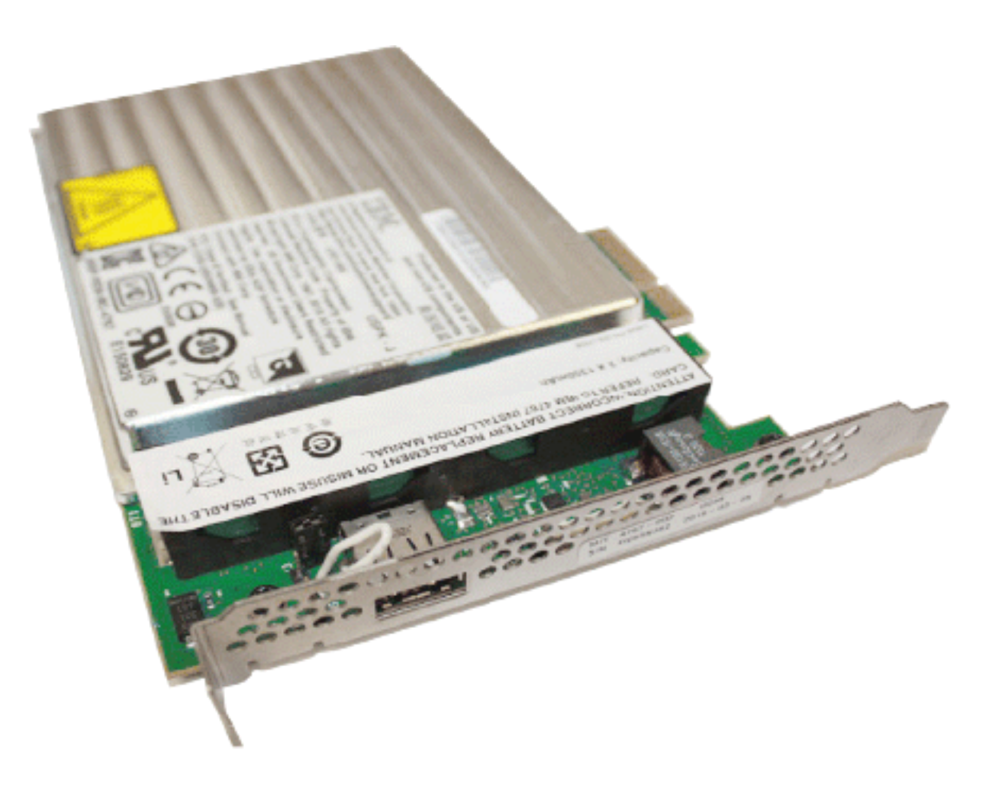
Air Gap Separation
EAL5+ Certification
Workload Isolation
Firmware ensures separation of running systems/VM’s on the same physical machine.
Hardware Security Module (HSMs)
Notes:
firmware virtualization of logical partitions (LPARs)
EAL5+, one of the highest commer-cially available certifications.

Slide 26
Chaincode Encryption
In certain scenarios, it may be useful to encrypt values associated with a key in their entirety or simply in part. For example, if a person’s social security number or address was being written to the ledger, then you likely would not want this data to appear in plaintext.
Chaincode encryption is achieved by leveraging the entities extension which is a BCCSP wrapper with commodity factories and functions to perform cryptographic operations such as encryption and elliptic curve digital signatures.
For example, to encrypt, the invoker of a chaincode passes in a cryptographic key via the transient field. The same key may then be used for subsequent query operations, allowing for proper decryption of the encrypted state values.

Slide 27
Privacy
Channels
MSP/ Identity
Private Data
Compliance / Legal
Notes:
MSP Membership Provider
Membership Service Provider (MSP) comes into play — it identifies which Root CAs and Intermediate CAs are trusted to define the members of a trust domain, e.g., an organization, either by listing the identities of their members, or by identifying which CAs are authorized to issue valid identities for their members, or — as will usually be the case — through a combination of both.
The power of an MSP goes beyond simply listing who is a network participant or member of a channel. An MSP can identify specific roles an actor might play either within the scope of the organization the MSP represents (e.g., admins, or as members of a sub-organization group), and sets the basis for defining access privileges in the context of a network and channel (e.g., channel admins, readers, writers).

Slide 28
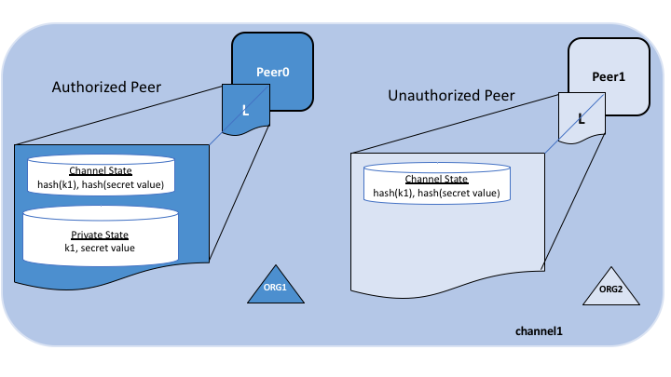
Private Data Collections
Offchain -> SideDB
A hash of that data, which is endorsed, ordered, and written to the ledgers of every peer on the channel.
Notes:
In cases where a group of organizations on a channel need to keep data private from other organizations on that channel, they have the option to create a new channel comprising just the organizations who need access to the data.
However, creating separate channels in each of these cases creates additional administrative overhead (maintaining chaincode versions, policies, MSPs, etc), and doesn’t allow for use cases in which you want all channel participants to see a transaction while keeping a portion of the data private.
The actual private data, sent peer-to-peer via gossip protocol to only the organization(s) authorized to see it. private state database on the peers of authorized organizations (sometimes called a “side” database, or “SideDB”),
The ordering service is not involved here and does not see the private data.
The hash serves as evidence of the transaction and is used for state validation and can be used for audit purposes.
Collection members may decide to share the private data with other parties if they get into a dispute or if they want to transfer the asset to a third party. The third party can then compute the hash of the private data and see if it matches the state on the channel ledger, proving that the state existed between the collection members at a certain point in time.

Slide 29
Go language is ported and optimized for LinuxONE to make these hardware solutions available for Hyperledger Fabric
Notes:
HLF WRITTEN in GO

Slide 30
Zero Knowledge Asset Transfer

Slide 31
Zero-knowledge proof (ZKP) technologies in Hyperledger Fabric “A zero-knowledge proof (ZKP) allows a “prover” to assure a “verifier” that they have knowledge of a secret without revealing the secret itself. It’s a way to show you know something that satisfies a statement without showing what you know.“ Here’s a basic example to demonstrate the power of ZKP. If you show your ID to the bouncer at a bar, you end up revealing your name, address, and age. If you used ZKP, you would be able to transform your ID into another form that would preserve the fact that it is a valid ID and the fact that you meet the bar’s age requirements, while concealing your name, address, and exact age. Two privacy aspects of Hyperledger Fabric will be achieved using ZKPs: Anonymous client authentication with Identity Mixer, and privacy-preserving exchange of assets with Zero-Knowledge Asset Transfer (ZKAT).
https://developer.ibm.com/tutorials/cl-blockchain-private-confidential-transactions-hyperledger-fabric-zero-knowledge-proof/

Slide 32
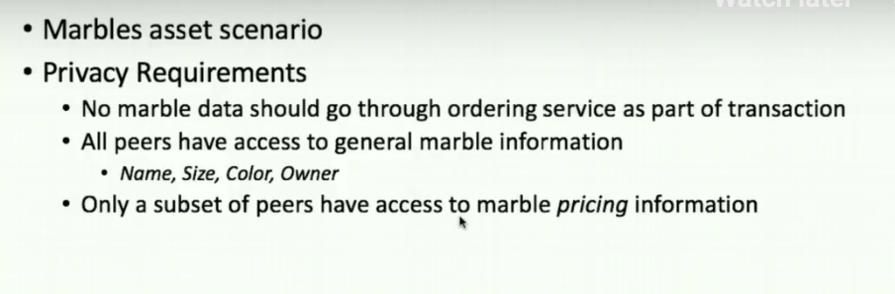
Private data – Marbles asset scenario
Notes:
Off video

Slide 33
Private data – Marbles asset scenario
Notes:
Off video

Slide 34
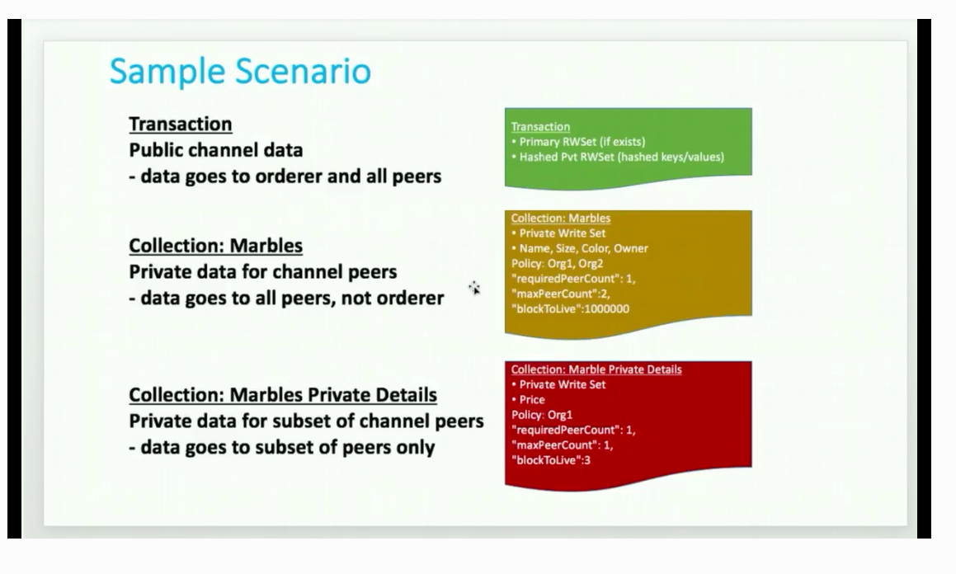
Private data: Marbles asset scenario
Notes:
If one peer offline it’s OK
Only Org 1 has access
Also
Block to live – even private data can expire ( super sensitive )
blockToLive: 3 – 3 blocks then purged ( 0 forever )

Slide 35
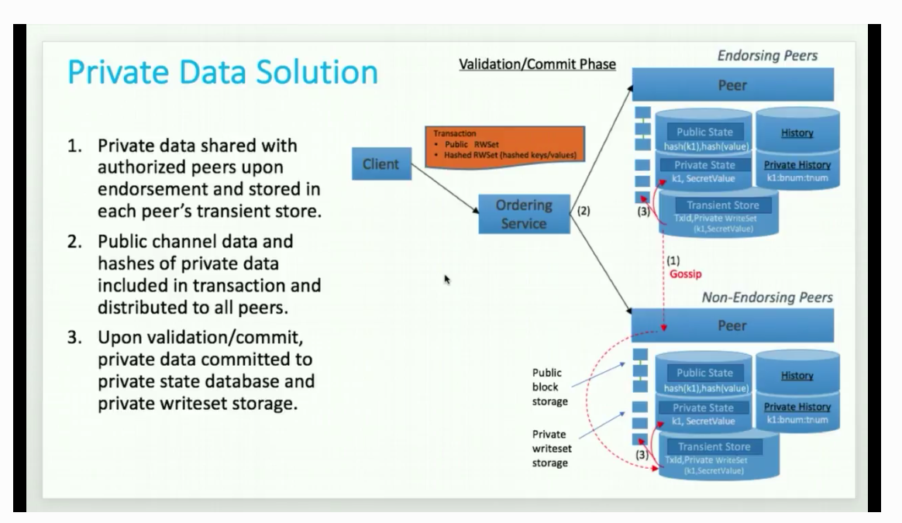
3 steps
Notes:
Off video

Slide 36
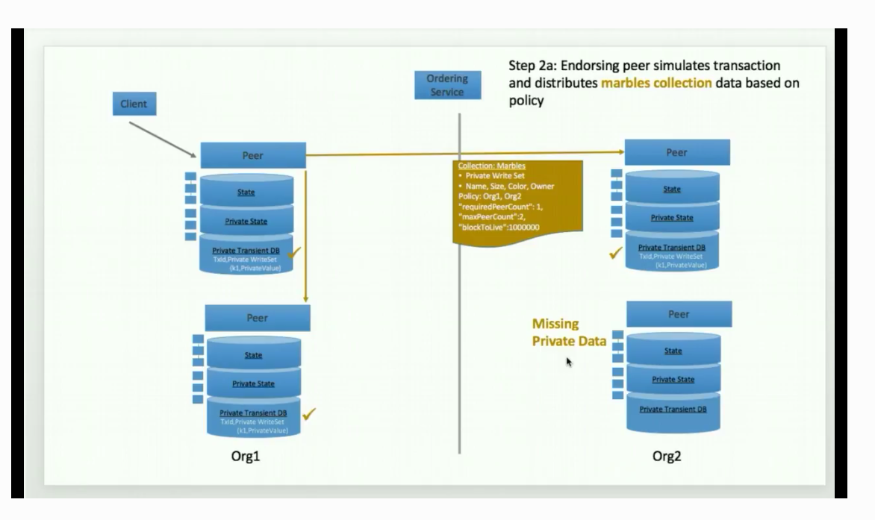
Flow – Step 2a
Notes:
If one peer offline it’s OK
Only Org 1 has access
Also
Block to live – even private data can expire ( super sensitive )
blockToLive: 3 – 3 blocks then purged ( 0 forever )

Slide 37
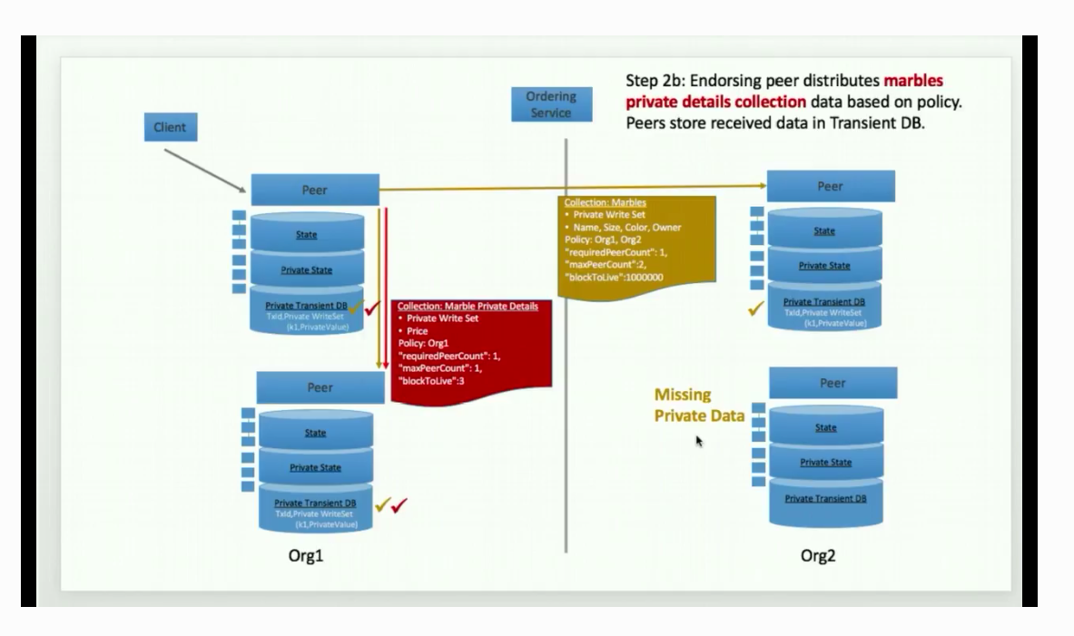
Flow 2b
Notes:
Second collection with marble pricing info
Sent to 1 peer

Slide 38
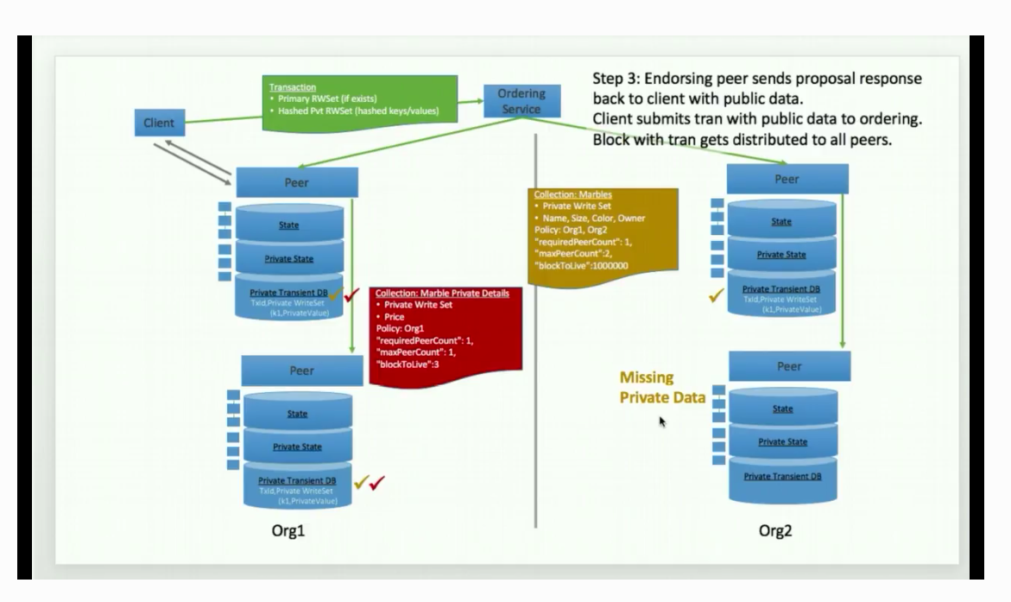
Private data – based of the infamous Marbles asset scenario
Notes:
Step 3
Endorsing peer sends proposal ….

Slide 39
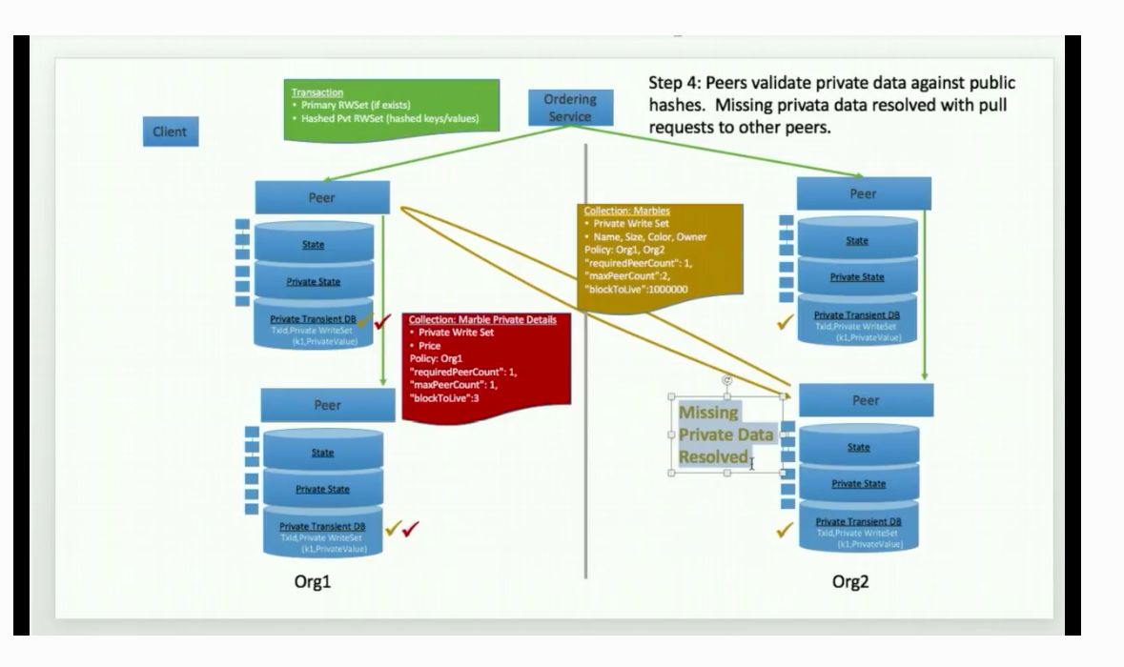
Private data – based of the infamous Marbles asset scenario
Notes:
Step
Missing private data

Slide 40
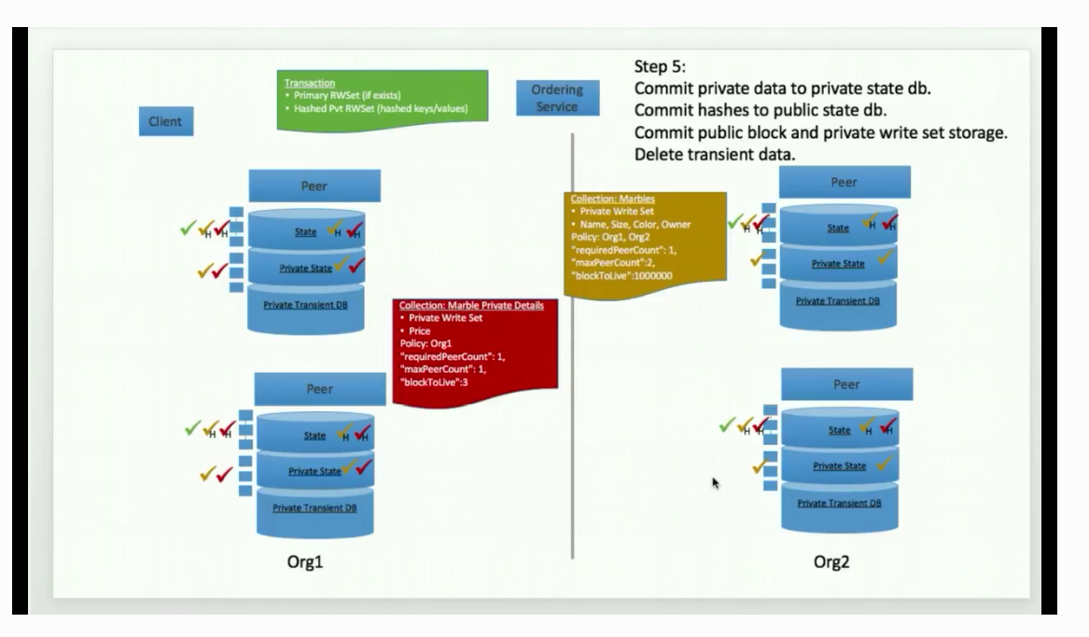
Private data – based of the infamous Marbles asset scenario
Notes:
Step 5

Slide 41

CODE
Notes:
Private Data HLF Tutorial Marble Data https://hyperledger-fabric.readthedocs.io/en/release-1.4/private_data_tutorial.html

Slide 42
Hyperledger Fabric (HLF) ==> LEARNING PATHS / REFERENCES
Hyperledger Fabric Tutorials Private Data Tutorial Marble Data https://hyperledger-fabric.readthedocs.io/en/release-1.4/private_data_tutorial.html IBM Code Patterns [ https://developer.ibm.com ]
Build your first private blockchain network on InterPlanetary File System
Comprehensive storage solution addresses data loss, duplication, tampering problems, and more
https://developer.ibm.com/patterns/build-first-private-blockchain-network-interplanetary-file-system/
Medical Data using IBM Cloud IBPv2 https://developer.ibm.com/patterns/storing-private-data-off-chain-using-blockchain-think-healthcare-use-case
IBM LinuxONE for dummies
https://www.ibm.com/downloads/cas/LBOVYYJJ
HLF security audit process https://www.hyperledger.org/blog/2018/02/07/hyperledger-fabric-1-0-release-process
Blockchains and SmartContract security - Chris Wysopal, CTO Veracode
https://searchsecurity.techtarget.com/news/252460033/Chris-Wysopal-talks-blockchain-hype-and-realistic-uses

Slide 43
Practical Byzantine Fault Tolerance
http://pmg.csail.mit.edu/papers/osdi99.pdf Private vs. Public Blockchain: What are the Major Differences? https://medium.com/luxtag-live-tokenized-assets-on-blockchain/private-vs-public-blockchain-what-are-the-major-differences-d92a504f3a4a
The Ultimate Guide to Consensus in Hyperledger Fabric
https://www.skcript.com/svr/consensus-hyperledger-fabric/
Hyperledger Fabric (HLF) ==> LEARNING PATHS / REFERENCES

Slide 44

Thank you!
Faces of IBM
https://w3.ibm.com/w3publisher/faces-of-ibm/faces-of-pride
Join Call for Code
https://callforcode.org/
https://bit.ly/2xf0PvK
Future events:
Master Reactive Systems on IBM Cloud using Lagom Microservices [Hands-on]
https://www.meetup.com/ibmcodenyc/events/262583689/
IBM Cloud
<><VCPI URL>
OR
https://cloud.ibm.com
Notes:
The winner of the first Call for Code Global Award received $200,000, open source project support from The Linux Foundation

